Slide 1


4-H Family News - St. Clair County
MARCH 2025
Karly Creguer
District Director
Counties: St. Clair, Huron,
Lapeer, Sanilac, and Tuscola.
Lori Warchuck
4-H Program Coordinator
Val Fusee
4-H Program Assistant
Email
msue@stclaircounty.org
Website:
msue.stclaircounty.org
Phone:
810-989-6935
MSU Extension Office:
St. Clair County Building
200 Grand River Ave #102
Port Huron, MI 48060
From Lori Warchuck’s Desk,
The beginning of a new 4-H year brings out good intentions from many of us, members and leaders alike. Sometimes our enthusiasm for the competitive part of our 4-H experience can overshadow our good intentions and real mission of our 4-H activities.
While it is often thought that participation in competitive events builds good character, it doesn’t automatically happen. Just as a 4-H leader has a plan for each meeting or event for the 4-H year, we need to develop an action plan for learning good sportsmanship through our 4-H activities.
Good sportsmanship is a critical skill for youth. Competitive events and activities provide a great opportunity for youth to learn how to be fair, respectful and gracious -- whether they win or lose. Let’s not leave this important skill to chance and add a sportsmanship component to your club meetings and activities.
To help youth practice this important skill, Michigan 4-H Youth Development has developed a series of sportsmanship activities that can be used at club meetings, events or other youth activities.
Remember, exhibiting good sportsmanship is not just for youth 4-H members – it applies to everyone involved, including volunteers, parents, leaders and others.
https://www.canr.msu.edu/re sources/4_h_sportsmanship_activity_series
Sportsmanship: What is it?
Common Ground
Good Sports Greeting Cards
Pass the Fruit
Sportsmanship Role Play.
Lori Warchuck
4-H Program Coordinator
MSU is an affirmative-action, equal-opportunity employer, committed to achieving excellence through a diverse workforce and inclusive culture that encourages all people to reach their full potential. Michigan State University Extension programs and materials are open to all without regard to race, color, national origin, gender, gender identity, religion, age, height, weight, disability, political beliefs, sexual orientation, marital status, family status or veteran status. Issued in furtherance of MSU Extension work, acts of May 8 and June 30, 1914, in cooperation with the U.S. Department of Agriculture. Quentin Tyler, Director, MSU Extension, East Lansing, MI 48824. This information is for educational purposes only. Reference to commercial products or trade names does not imply endorsement by MSU Extension or bias against those not mentioned.

Slide 2
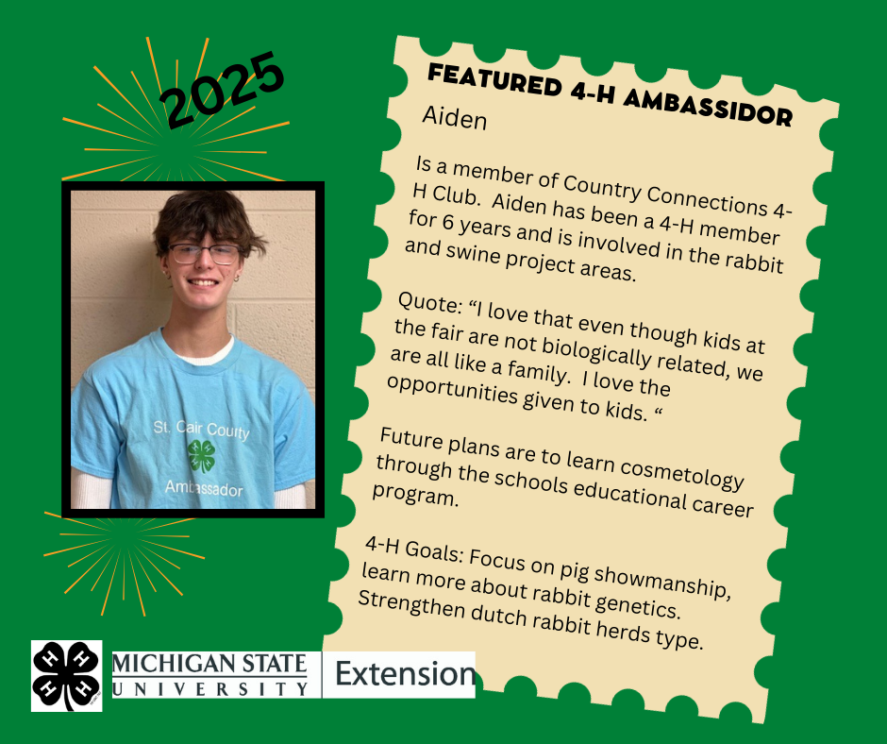
Featured 4-H Ambassador

Slide 3
4-H Council Auction Wrap Up
The 2025 4-H Auction took place on Saturday, February 22, 2025 at Goodells Park was a success. There were 409 items sold that totaled $16881.40 with 16 4-H Clubs participated in soliciting the auction items.
Club contest results:
1st – Rimrock Acers 4-H Club with $6701.50 in sales 156 items
2nd - Country Connections 4-H Club with $3,521.50 in sales 105 items
4th - Clovers Kids 4-H Club with $871.00 in sales 12 items
Other clubs participating – Brockway, Country Clovers, Equestrian Express, Furry Friends, Great Expectations, Hay Busters, Mane Attraction, Mis-Placed Riders, No Limits, Rustic Ramblers, SCC Sharp Shooters, West St Clair. Thank you to all the club leaders that made the 4-H Council Auction a priority in their club.
Thank you to John Tomascko and his crew of JRT Thumb Auctioneering Auction Service for over 36 years of support.

Slide 4
St. Clair County Events
Local Calendar
March
3/10 – Fair Board Meeting, 7pm, Goodells
3/12 – 4-H Poultry Workshop, 6pm – 8pm, Goodells (pre-registration required)
3/15 – From the Forest to the Table, 4 Square Sportsman’s Club Jeddo (pre-registration required)
3/17 – 4-H Council Meeting, 7pm, Goodells
3/20 – 4-H Horse Leaders Meeting, 7pm, Goodells
April
4/4 – 4-H Clover Sprouts Discovery Center Adventure, 5pm – 7pm, Port Huron (pre-registration required)
4/10 – 4-H Craft Night, 6pm – 8pm, Goodells (pre-registration required)
4/14 – Fair Board Meeting, 7pm, Goodells
4/14 – 4-H Club Officer Training, 6pm – 8pm, Goodells (pre-registration required)
4/16 – 4-H Flower Arranging Workshop 6:30pm – 8pm, Goodells (pre-registration required)
4/25-26 – Earth Fair – Goodells
May
5/10 – Sheep Showmanship Clinic, Goodells (pre-registration required)
5/10 – Horse Round Robin Clinic, Goodells (pre-registration required)
5/12 – Fair Board Meeting, 7pm, Goodells
5/17 – John Tate Memorial Horse Show, Goodells
5/31 – 4-H Rabbit Skill-A-Thon, Goodells (SAVE THE DATE)
More information about 4-H events can be found online:
St. Clair County 4-H Facebook page: https://m.facebook.com/4Hstclaircounty
https://www.canr.msu.edu/4h/events
https://msue.stclaircounty.org
(810) 989-6956

Slide 5
St. Clair County Events Continued
Local Calendar
June
6/9 – Fair Board Meeting, 7pm Goodells
6/21 – Warm Up Horse Show
6/22 – State 4-H Qualified Horse Show
6/24 – 6/26 – Thumb Area 4-H Camp
6/28 – Shooting Sports Tournament Blue Water Sportsman’s Club
6/29 – Archery Tournament Goodells
July
7/14-7/19 SCC 4-H & Youth Fair
More information about 4-H events can be found online:
St. Clair County 4-H Facebook page: https://m.facebook.com/4Hstclaircounty
https://www.canr.msu.edu/4h/events
https://msue.stclaircounty.org
(810) 989-6956

Slide 6


4-H & Youth Fair Update
Volunteers sought for superintendents at the fair.
Help set up and tear down the still exhibit barn, get judges for your project area and facilitate judging at the fair.
For your service, receive a weekly admission pass to the fair, a volunteer's shirt, and enduring gratitude of our 4-H & youth exhibitors and adult volunteers.
To be a superintendent at the fair, fill out an application at: https://stclaircounty4hfair.org/wp-content/uploads/2023/09/Superintendent-Application.pdf?fbclid=IwZXh0bgNhZW0CMTAAAR0I1pC78M0-oM_ZzMZFZDG6UKO8N1AlgQcLliA5ahAqM_17k3W16TfahLU_aem_jt0wMAcrtt-IZYtjUcuFMA

Slide 7
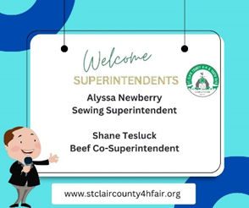
Welcome the following new project superintendents!

Slide 8
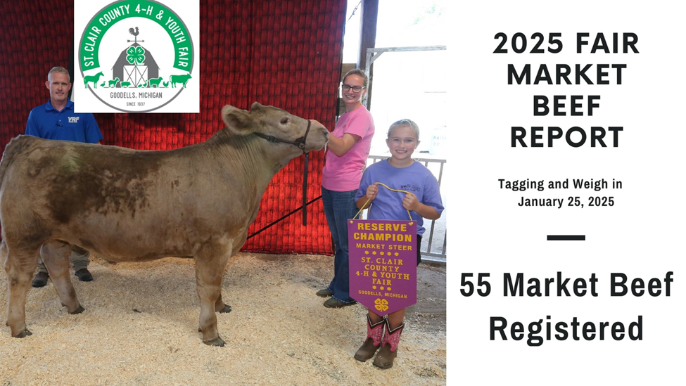
Beef Weigh in Results

Slide 9

4-H & Youth Fair Update

Slide 10
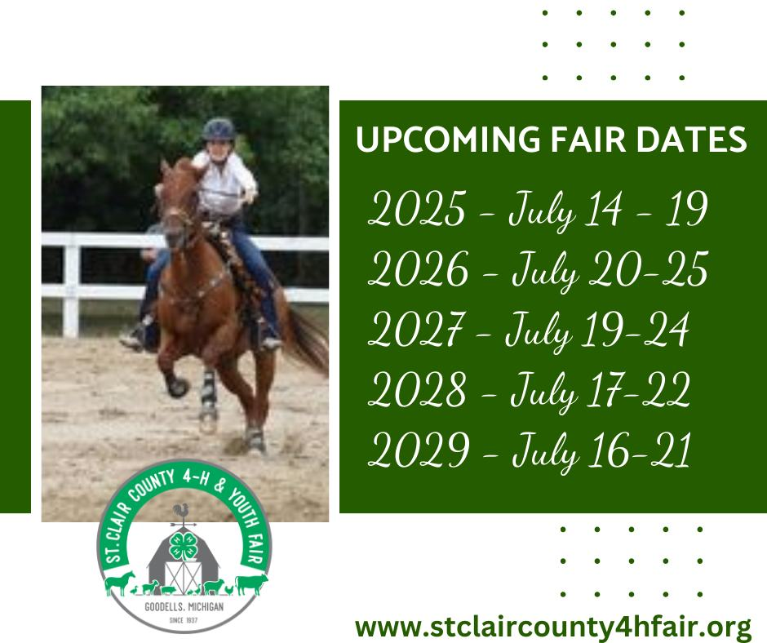
4-H & Youth Fair Update

Slide 11

SAVE THE DATE

Slide 12

SAVE THE DATE

Slide 13

SAVE THE DATE

Slide 14
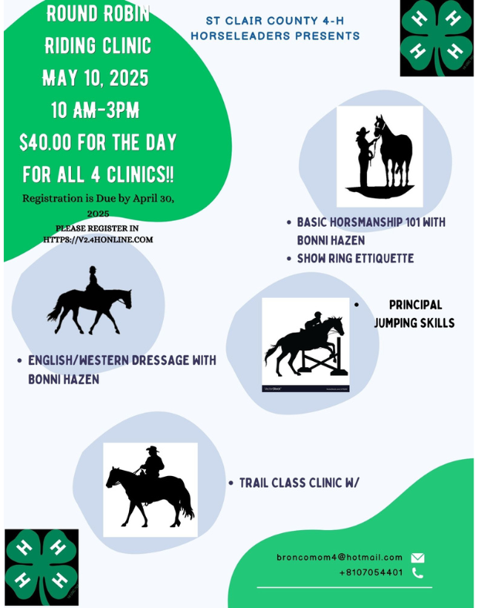
SAVE THE DATE

Slide 15
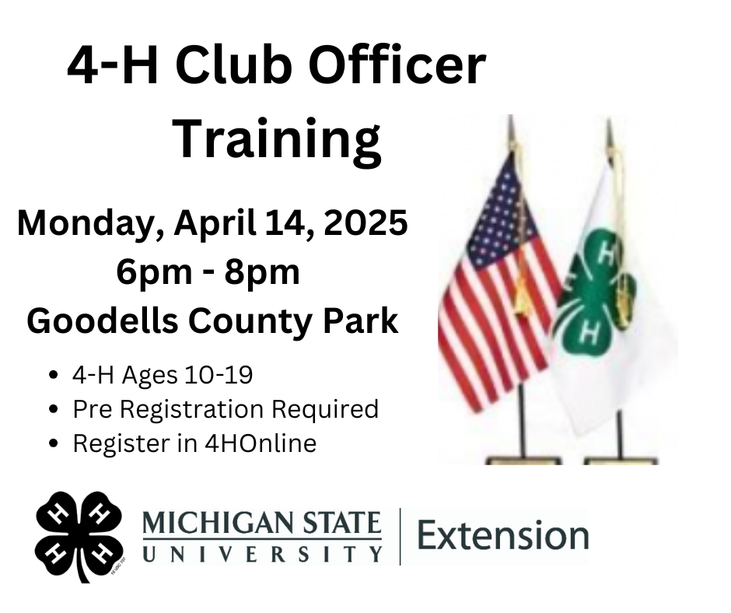
SAVE THE DATE

Slide 16

SAVE THE DATE

Slide 17

SAVE THE DATE

Slide 18
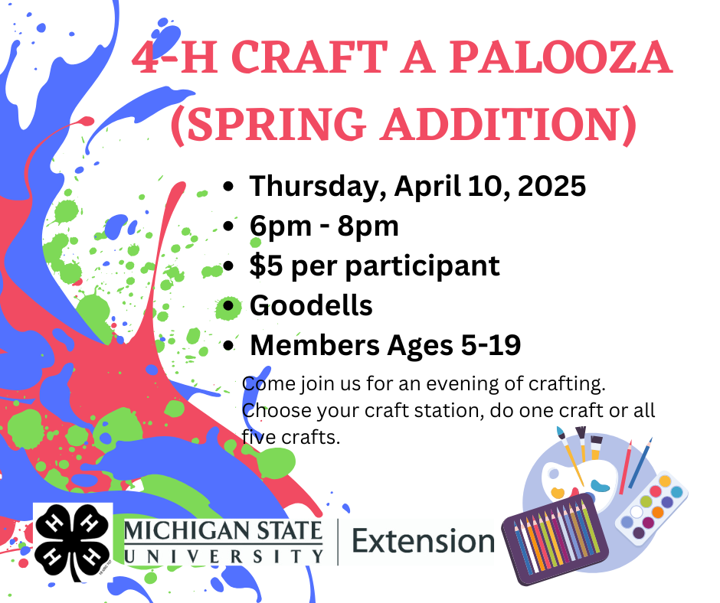
SAVE THE DATE

Slide 19
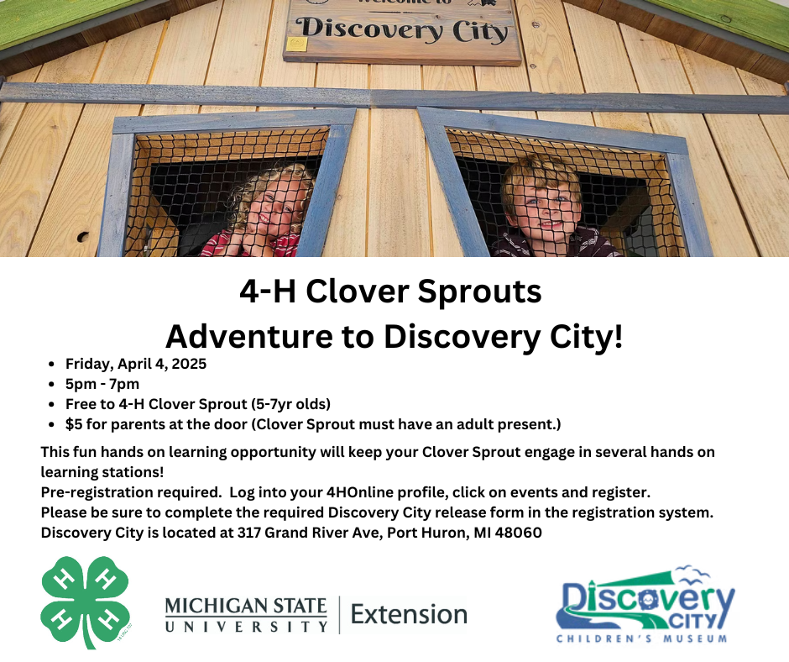
SAVE THE DATE

Slide 20
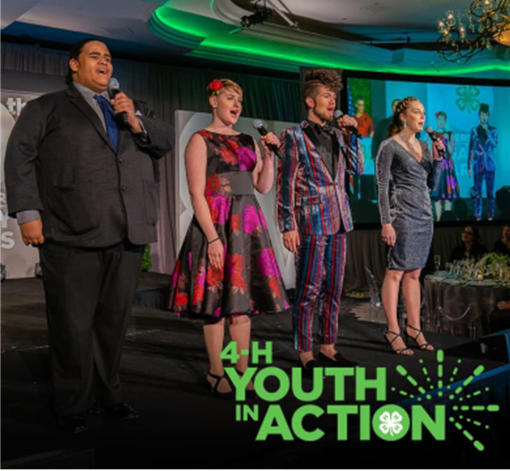
4-H Youth in Action Program applications open
March 3: Adulting 101 – Get It Together: Tim and Organization Tips to Thrive
Online
Learn practical tips to tackle schedules, beat procrastination and organize spaces to help you be successful now and in the future.
www.canr.msu.edu/events/get-it-together
March 11: 4-H Give Green Day
Online
Help us reach our goal of raising $5,000 in a 24-hour period on Give Green Day to support learning experiences for Michigan 4-H youth.
www.canr.msu.edu/events/4h-give-green-day
March 11: Wild Spartans
Online
Join 4-H staff for the "Wild Spartans" series for a look into life working with fisheries and wildlife! This month’s session will explore conservation efforts in zoos with Seth Magle, director of the Urban Wildlife Institute at the Lincoln Park Zoo in Chicago.
www.canr.msu.edu/events/wild-spartans-monthly-wildlife-fisheries-webinar-series-march-2024-2025
March 15: Michigan 4-H Hippology Contest
East Lansing
Youth aged 5-19 are eligible to demonstrate their comprehensive equine knowledge and skills in an engaging setting.
www.canr.msu.edu/events/2025-michigan-4-h-state-hippology-contest
March 18: Mich. 4-H Volunteer Webinar - Cultivating Developmental Relationships with Youth
Online
Explore how to build impactful connections with youth through developmental relationships. This series will provide volunteers with a variety of learning opportunities to help them grow as a volunteer and support Michigan 4-H’ers. This session will be offered twice:
  12 p.m. session: www.canr.msu.edu/events/michigan-4-h-volunteer-webinar-series-the-heart-of-4-h-cultivating-developmental-relationships-with-youth-noon
  7 p.m. session: www.canr.msu.edu/events/michigan-4-h-volunteer-webinar-series-the-heart-of-4-h-cultivating-developmental-relationships-with-youth-7pm
April 1: 2025 Michigan 4-H State Awards application deadline
Online
This program provides 4-H members a learning experience where they can develop career skills by using their 4-H experiences to compile a portfolio similar to a professional application while receiving recognition for their 4-H involvement.
www.canr.msu.edu/events/2025-michigan-4-h-state-awards-application-deadline
Apply now for the 2026 4-H Youth in Action Awards! Each year, the program recognizes four confident young leaders with diverse backgrounds and unique perspectives who are making a difference in their communities.
Winners will have the once-in-a-lifetime opportunity to share their stories along with unforgettable experiences, celebration on the national stage, recognition in the media and a $5,000 college scholarship.
This opportunity is open to youth ages 14-19. The deadline to apply is March 31. Learn more and apply at https://4-h.org/programs/4-h-youth-in-action-program/application/.

